Slide 1
Lab No:3 Phylum : Sarcomastigophora Subphylum : Mastigophora Class : phytomastigophora Family : Euglenceae Genus : Euglena The mastigophora or flagellates characterized by having one or more flagella Member of Euglena are spindle shaped , greenish , this color caused by presence of chloroplast which contain chlorophyll .

Slide 2
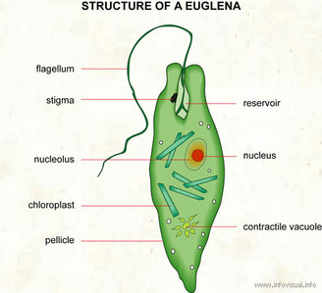
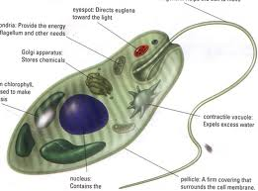
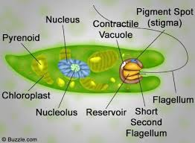
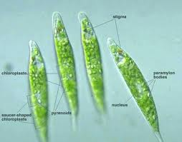

Slide 4
Phylum : Sarcomastigophora
Subphylum : Mastigophora
Class : Zoomastigophora
Order :Kinetoplastida
Genus : Trypanosoma
Trypanosome is a zooflagellates that are parasite in the blood and other tissue of all class of vertebrates , they lack chlorophyll and it is obtain there organic and inorganic requirement from environment in which they live by osmotrophic directly from surrounding blood or body fluid .
Some Trypanosoma are non pathogenic but others pathogenic caused disease especially sleeping sickness .

Slide 5
